Slide 1
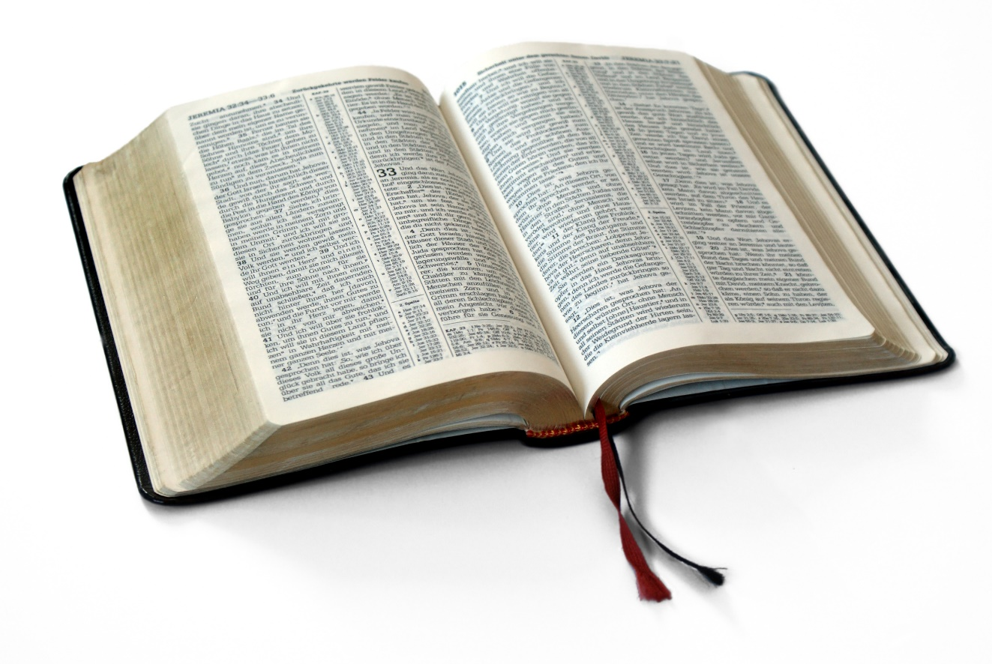
Great Verses
of the Bible
Genesis 12:1-3

Slide 2
Genesis 12:1-3
God keeps his promises.
Great Verses
of the Bible

Slide 3
Genesis 12:1-3
We can be heirs of the promise.
Great Verses
of the Bible

Slide 4
Great Verses
of the Bible
Genesis 12:1-3

