Slide 2
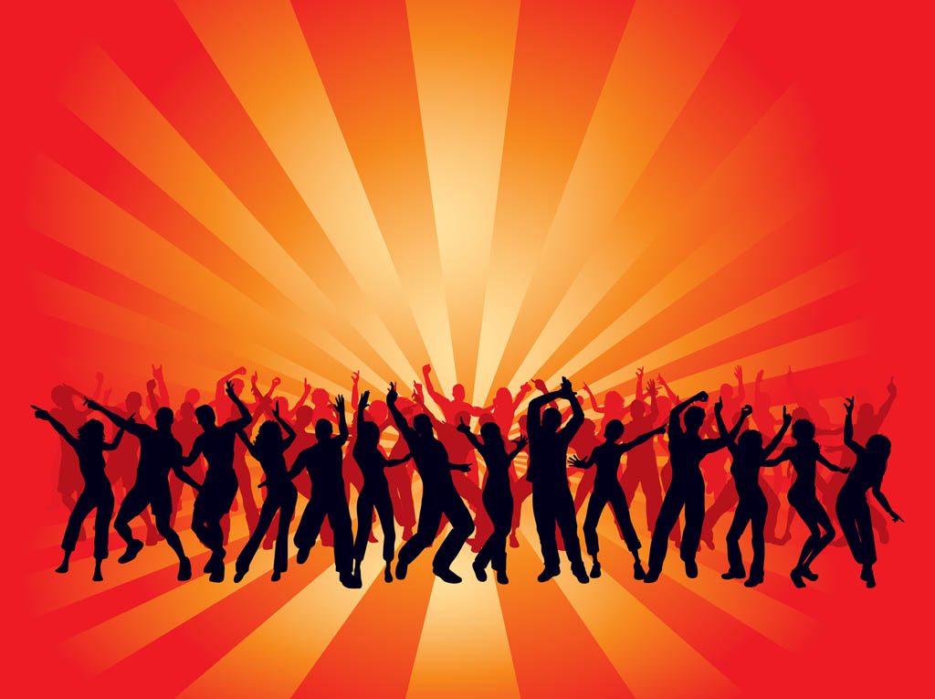
SHALL WE DANCE?
What does the Bible say?

Slide 3
Dancing…
…is not condemned in the Bible.
(but lasciviousness and sensuality is)

Slide 4
Dancing…
…can harm your influence
(and associate you with the world)

