Slide 1
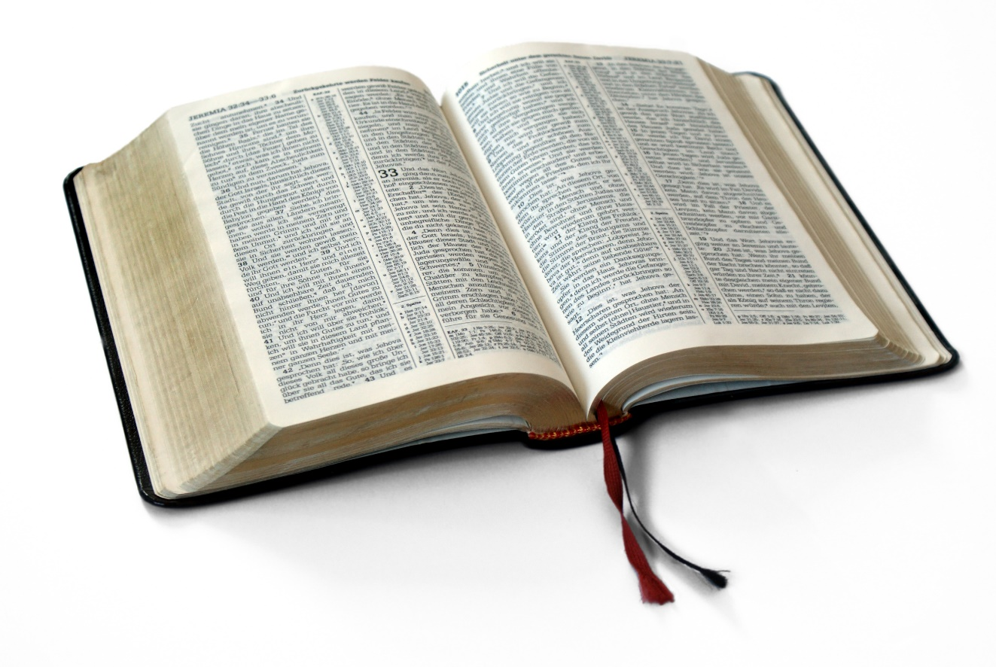
Great Verses
of the Bible
Deuteronomy 8:3

Slide 2
Deuteronomy 8:3
We are utterly dependent upon God.
Great Verses
of the Bible

Slide 3
Deuteronomy 8:3
Remember the LORD when you have eaten and are full.
Great Verses
of the Bible

Slide 4
Deuteronomy 8:3
The spiritual is far more important than the physical.
Great Verses
of the Bible

Slide 5
Great Verses
of the Bible
Deuteronomy 8:3

