Slide 2
Parables
Kingdom
of the
The kingdom of heaven is like...
A growing seed
Matthew 13

Slide 3
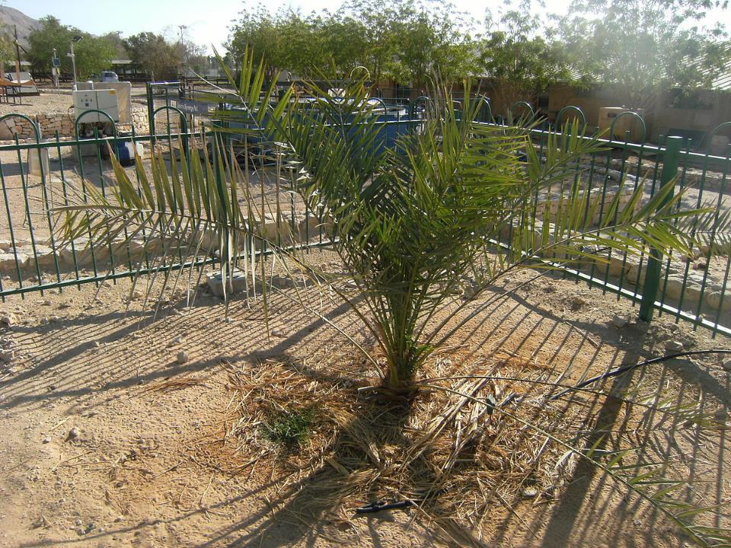

Slide 4
Parables
Kingdom
of the
The kingdom of heaven is like...
A growing seed
A man who sowed good seed
Matthew 13

Slide 5
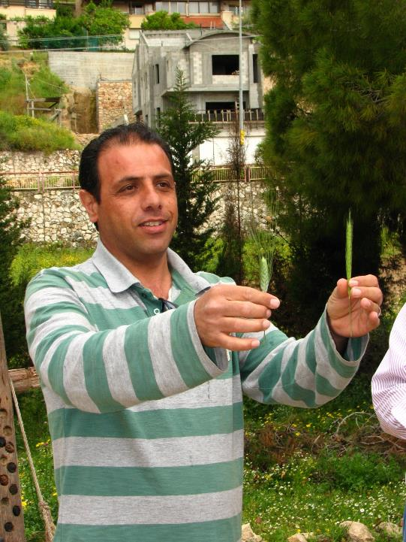

Slide 6
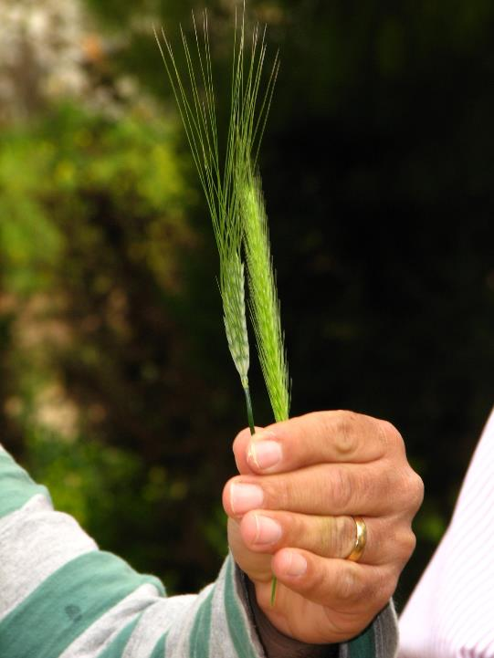

Slide 7
Parables
Kingdom
of the
The kingdom of heaven is like...
A growing seed
A man who sowed good seed
A mustard seed
Leaven
Treasure hidden in a field
A merchant seeking beautiful pearls
Dragnet
Householder
Matthew 13

