Slide 1
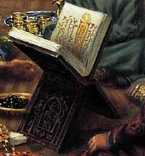
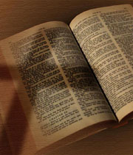
Exploring
Islam & Christianity

Slide 2
Definitive
Differences

Slide 3
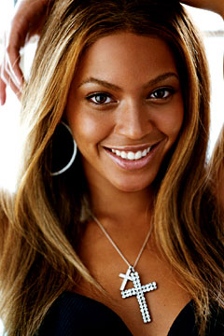
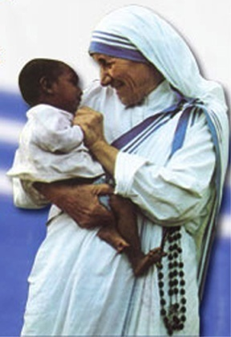
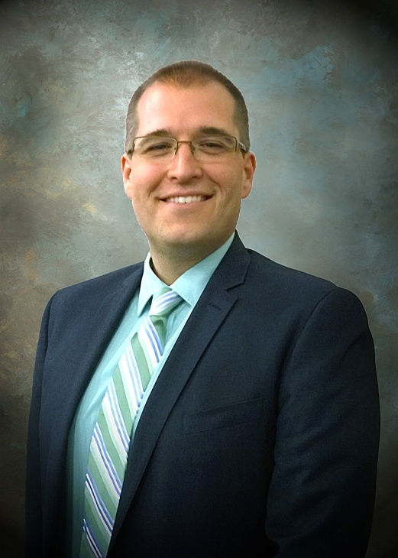
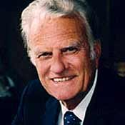
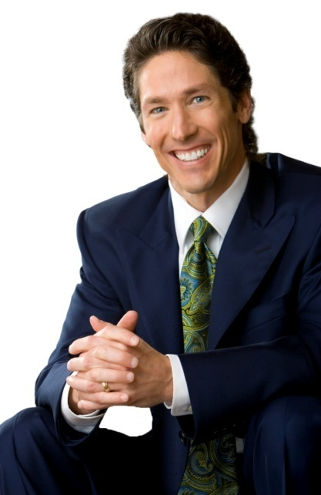
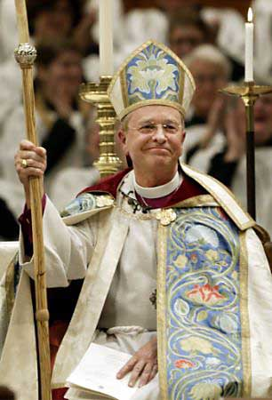
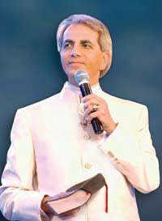
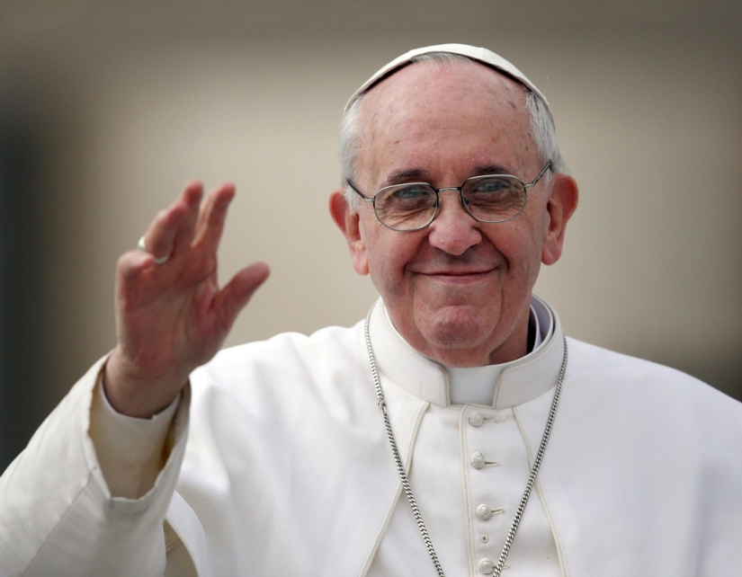
All are “Christian” (In Muslim Eyes), But Do All Believe and Practice Alike?
Beyonce
Mother Teresa
Andrew Roberts
Billy Graham
Joel Osteen
Bishop Gene Robinson
Benny Hinn
Pope Francis

Slide 4
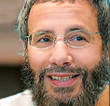
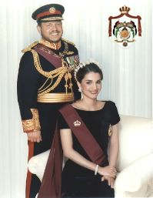
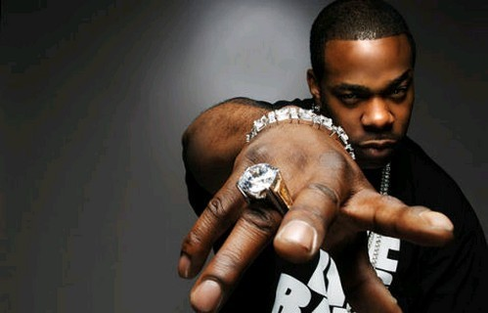
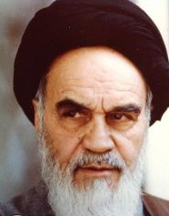
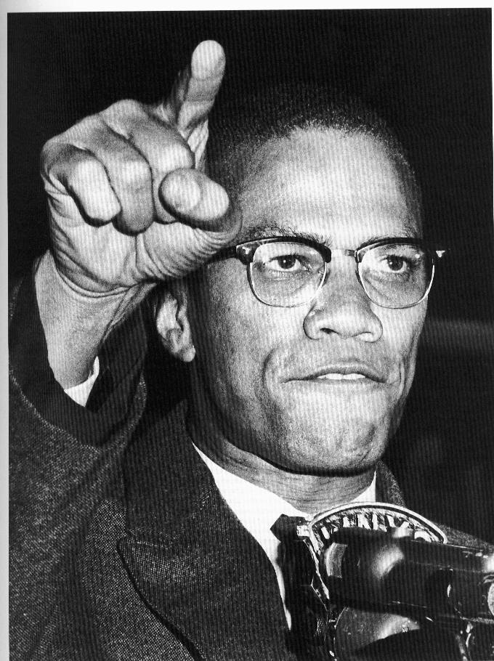
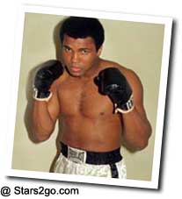
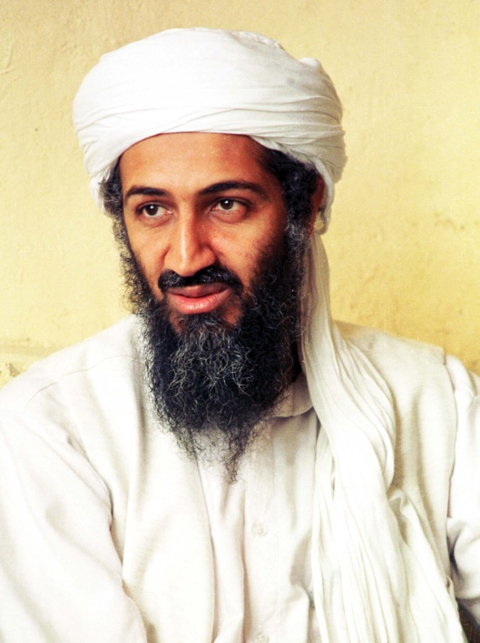
All are “Muslim” (In Christian Eyes), But Do All Believe and Practice Alike?
Yusuf Islam/ Cat Stevens
Queen Rania Al-Abdullah
Busta Rhymes
Asma Gull Hasan
Ayatollah Khomeini
Osama Bin Laden
Malcolm X
Muhammad Ali

Slide 5
Basic Islam Information
Islam - “Submission”
Over 1 Billion adherents
Geography: North Africa, Middle East, Russia, India, Indonesia, Philippines
10 Million Muslims in Americas

Slide 6
A Different GOD
Definitive
Differences

Slide 7
SURAH 2:136
Say: “We believe in God and what has been sent down to us, and what had been revealed to Abraham and Ishmael and Isaac and Jacob and their progeny, and that which was given to Moses and Christ, and to all other prophets by the Lord. We make no distinction among them, and we submit to Him.”

Slide 8
SURAH 29: 46
Do not argue with the people of the Book unless in a fair way, apart from those who act wrongly, and say to them: “We believe what has been sent down to you. Our God and your God is one, and to Him we submit.”

Slide 9
Islam teaches there is no Godhead, only Allah
Definitive
Differences

Slide 10
SURAH 4:171 b
So believe in God and His apostles, and do not call Him ‘Trinity.’ Abstain from this for your good; for God is only one God, and far from His glory is it to beget a son. All That is in the heavens and the earth belongs to Him; and sufficient is God for all help.

Slide 11
SURAH 9:31
They consider their rabbis and monks and the Christ, son of Mary, to be gods apart from God, even though they had been enjoined to worship only one God, for there is no god but He. Too holy is He for what they ascribe to Him!

Slide 12
SURAH 17:111
And say: “All praise be to God who has neither begotten a son nor has a partner in His kingdom; nor has He need of any one to protect Him from ignominy. So extol Him by extolling His majesty.”

Slide 13
Father is God
Godhead consists of 3 distinct persons, each possessing ALL attributes of deity.

Slide 14
1 Corinthians 1:3
Grace to you and peace from God our Father and the Lord Jesus Christ.

Slide 15
Father is God
Godhead consists of 3 distinct persons, each possessing ALL attributes of deity.
Jesus is God

Slide 16
Titus 2:13
Looking for the blessed hope and glorious appearing of our great God and Savior Jesus Christ

Slide 17
Father is God
Godhead consists of 3 distinct persons, each possessing ALL attributes of deity.
Jesus is God
Holy Spirit is God

Slide 18
Acts 5:3-4
But Peter said, “Ananias, why has Satan filled your heart to lie to the Holy Spirit… You have not lied to men, but to God.”

Slide 19
Godhead consists of 3 distinct persons, each possessing ALL attributes of deity.
Father is God
Jesus is God
Holy Spirit is God
Distinct Forms at Jesus’ Baptism

Slide 20
Biblical References to Godhead
“Go therefore and make disciples of all nations, baptizing them in the name of the Father and the Son and the Holy Spirit.” – Matthew 28:19
“The grace of the Lord Jesus Christ, and the love of God, and the fellowship of the Holy Spirit, be with you all.” – 2 Corinthians 13:14

Slide 21
A Different JESUS
Definitive
Differences

Slide 22
SURAH 3:64
Tell them: “O people of the book let us come to an agreement on that which is common between us, that we worship no one but God, and make none His compeer, and that none of us take any others for lord apart from God.”

Slide 23
SURAH 4: 171
O people of the Book, do not be fanatical in your faith, and say nothing but the truth about God. The Messiah who is Jesus, son of Mary, was only an apostle of God, and a command of His which He sent to Mary, as a mercy from Him.

Slide 24
SURAH 5:75
The Christ, son of Mary, was but an apostle, and many apostles had (come and) gone before him…

Slide 25
The Bible affirms the deity of Jesus
And He was saying to them, “You are from below, I am from above; you are of this world, I am not of this world. I said therefore to you, that you shall die in your sins; for unless you believe that I am He, you shall die in your sins.” – John 8:23-24

Slide 26
A Different “BOOK”
Definitive
Differences

Slide 27
Christianity and the Bible
2 Peter 1:20-21, “knowing this first, that no prophecy of Scripture is of any private interpretation, for prophecy never came by the will of man, but holy men of God spoke as they were moved by the Holy Spirit.”

Slide 28
Christianity and the Bible
2 Peter 1:3, “As His divine power has given to us all things that pertain to life and godliness, through the knowledge of Him who called us by glory and virtue”

Slide 29
Christianity and the Bible
2 Timothy 3:16-17, “All Scripture is given by inspiration of God, and is profitable for doctrine, for reproof, for correction, for instruction in righteousness, that the man of God may be complete, thoroughly equipped for every good work.”
John 10:35, “Scripture cannot be broken.”

Slide 30
Christianity and the Bible
Matthew 15:6-9, “Thus you have made the commandment of God of no effect by your tradition. Hypocrites! Well did Isaiah prophesy about you, saying: "These people draw near to Me with their mouth, And honor Me with their lips, But their heart is far from Me. And in vain they worship Me, Teaching as doctrines the commandments of men.”

Slide 31
Islam and Revelation
SURAH 3:3, “He has verily revealed to you this Book, in truth and confirmation of the Books revealed before, as indeed He had revealed the Torah and the Gospel”
SURAH 7:157, “Who follow the messenger, the gentile Prophet, described in the Torah and the Gospel…”

Slide 32
Islam and Revelation
SURAH 22:52-53, “We have sent no messenger or apostle before you with whose recitations Satan did not tamper. Yet God abrogates what Satan interpolates; then He confirms His revelations, for God is all-knowing and all-wise.
This is in order to make the interpolations of Satan a test for those whose hearts are diseased and hardened: Surely the sinners have gone far in dissent.”

Slide 33
Islam and Revelation
SURAH 33:21, “You have indeed a noble paradigm in the Apostle of God for him who fears God and the Day of Resurrection, and remembers God frequently. ”

Slide 34
Islam and Revelation
Hadith – The Traditions
“The Prophet is caught as it were in the ordinary acts of his life – sleeping, eating, mating, praying, hating, dispensing justice, planning expeditions and revenge against his enemies […] morality derives from the Prophet’s actions; the moral is whatever he did. Morality does not determine the Prophet’s actions, but his actions determine and define morality. Muhammad’s acts were not ordinary acts; they were Allah’s own acts. It was in this way and by this logic that Muhammad’s opinions became the dogmas of Islam and his personal habits and idiosyncrasies became moral imperatives: Allah’s commands for all believers in all ages and climes to follow.”
- Phil Parshall, Understanding Muslim Teachings and Traditions

Slide 35
A Different HOPE
Definitive
Differences

Slide 36
SURAH 47: 15
The semblance of Paradise promised the pious and devout (is that of a garden) with streams of water that will not go rank, and rivers of milk whose taste will not undergo a change, and rivers of wine delectable to drinkers, and streams of purified honey, and fruits of every kind in them, and forgiveness of their Lord.

Slide 37
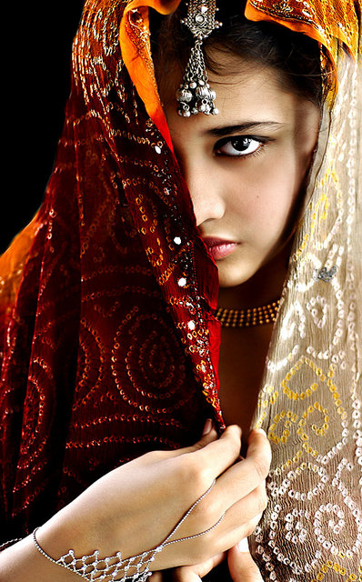
SURAH 4:57
But those who believe and do good deeds We shall admit into gardens with streams of running water, where they will abide for ever, with fairest of companions and coolest of shades.

Slide 38
SURAH 44:51-55
Surely those who fear and follow the straight path will be in a place of peace and security in the midst of gardens and springs, dressed in brocade and shot silk, facing one another… We shall pair them with companions with large black eyes. They will call for every kind of fruit with satisfaction

Slide 39
A Carnal Picture of Paradise or A Spiritual Reward of Heaven?
Definitive
Differences

Slide 40
1 Peter 1: 3-5
Blessed be the God and Father of our Lord Jesus Christ, who according to His great mercy has caused us to be born again to a living hope through the resurrection of Jesus Christ from the dead, to obtain an inheritance which is imperishable and undefiled and will not fade away, reserved in heaven for you, who are protected by the power of God through faith for a salvation ready to be revealed in the last time.

Slide 41
Mark 12: 24-25
Jesus said to them, “Is this not the reason you are mistaken, that you do not understand the Scriptures, or the power of God? For when they rise from the dead, they neither marry, nor are given in marriage, but are like angels in heaven.”

Slide 42
A Different TREATMENT of ENEMIES
Definitive
Differences

Slide 43
DIFFERENT TREATMENT
PERSONAL ENEMIES
Definitive
Differences

Slide 44
SURAH 22: 39-40
Permission is granted those (to take up arms) who fight because they were oppressed. God is certainly able to give help to those who were driven away from their homes for no other reason than they said: “Our Lord is God.”

Slide 45
DIFFERENT TREATMENT
PERSONAL ENEMIES
SPIRITUAL ENEMIES
Definitive
Differences

Slide 46
SURAH 47:4
So, when you clash with the unbelievers, smite their necks until you overpower them, then hold them in bondage. Then either free them graciously or after taking a ransom, until war shall have come to an end. If God had pleased He could have punished them (Himself), but He wills to test some of you through some others. He will not allow the deeds of those who are killed in the cause of God to go to waste.

Slide 47
DIFFERENT TREATMENT
PERSONAL ENEMIES
SPIRITUAL ENEMIES
NATIONAL ENEMIES
Definitive
Differences

Slide 48
SURAH 9:5
But when these months, prohibited (for fighting), are over, slay the idolaters wheresoever you find them, and take them captive or besiege them, and lie in wait for them at every likely place. But if they repent and fulfill their devotional obligations and pay the zakat, then let them go their way, for God is forgiving and kind.

Slide 49
SURAH 9:29
“Fight those people of the Book who do not believe in God and the Last Day, who do not prohibit what God and His Apostle have forbidden, nor accept divine law, until all of them pay protective tax in submission.

Slide 50
Definitive
Differences

