Slide 1
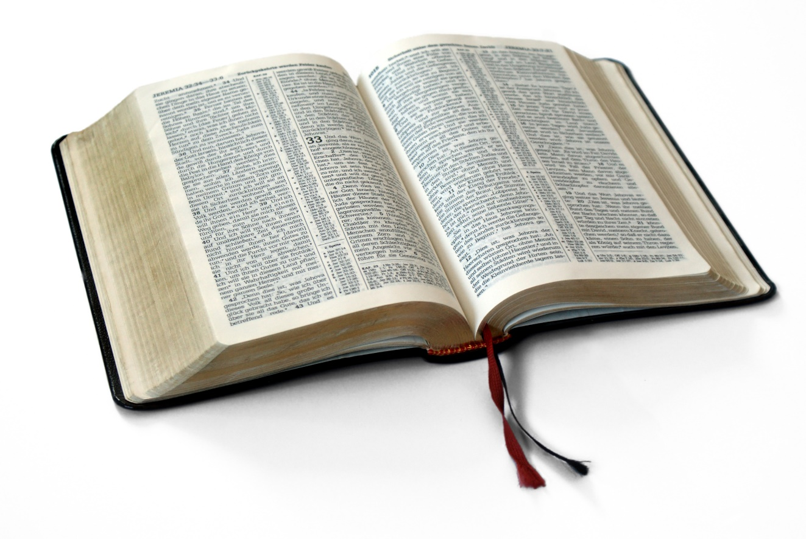
Great Verses
of the Bible
1 Samuel 16:7

Slide 2
1 Samuel 16:7
Don’t judge a book
by its cover.
Great Verses
of the Bible

Slide 3
1 Samuel 16:7
We can fool others,
but we can’t fool God.
Great Verses
of the Bible

Slide 4
Great Verses
of the Bible
1 Samuel 16:7

