Slide 1
From
Heaven
or
Men?
Matthew 21:23-27
Studies In
Bible Authority

Slide 2
Musical Instruments:
Does God
Care?
Studies In
Bible Authority

Slide 3
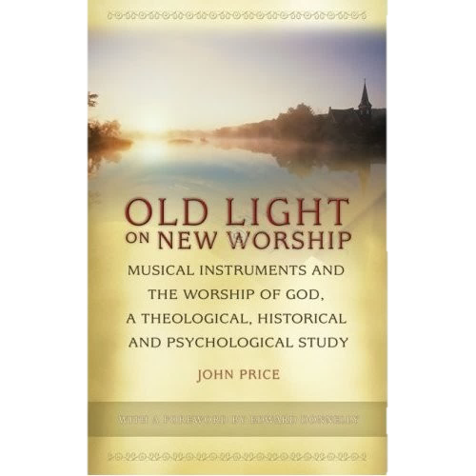
Musical Instruments:
Does God
Care?

Slide 4
God Has Always Regulated Worship
Numbers 10:1-10
1 Chronicles 16:1-6
1 Chronicles 23:1-5
1 Chronicles 28:11-13, 19
2 Chronicles 23:1-5, 18
2 Chronicles 29:25-29
2 Chronicles 35:4, 15
Ezra 3:10
Nehemiah 12:24, 35-36, 45-46
Musical Instruments:
Does God
Care?

Slide 5
God Has Always Regulated Worship
“The synagogue music was an adoption without musical instruments of the Temple music.”
Winford C. Douglas, Church Music in History and Practice
Musical Instruments:
Does God
Care?

Slide 6
God Has Always Regulated Worship
“Instruments were never used in ancient synagogue worship.”
McClintock and Strong, Cyclopedia of Biblical, Theological,
and Ecclesiastical Literature
Musical Instruments:
Does God
Care?

Slide 7
History of Musical Instruments in the Christian Age
670 in a Roman Catholic Church in Rome by Pope Vitalian
812 in a Roman Catholic Cathedral in France by Charlemagne
Remained isolated in its use until the late 1200s
Rejected by Protestant Reformers (1500s)
Rejected by Puritans, Presbyterians, Baptists, etc. (1600s)
Gradually gained popularity in the 1700s
Commonplace in the 1800s
Musical Instruments:
Does God
Care?

