Slide 1
The Birth
of Jesus

Slide 2
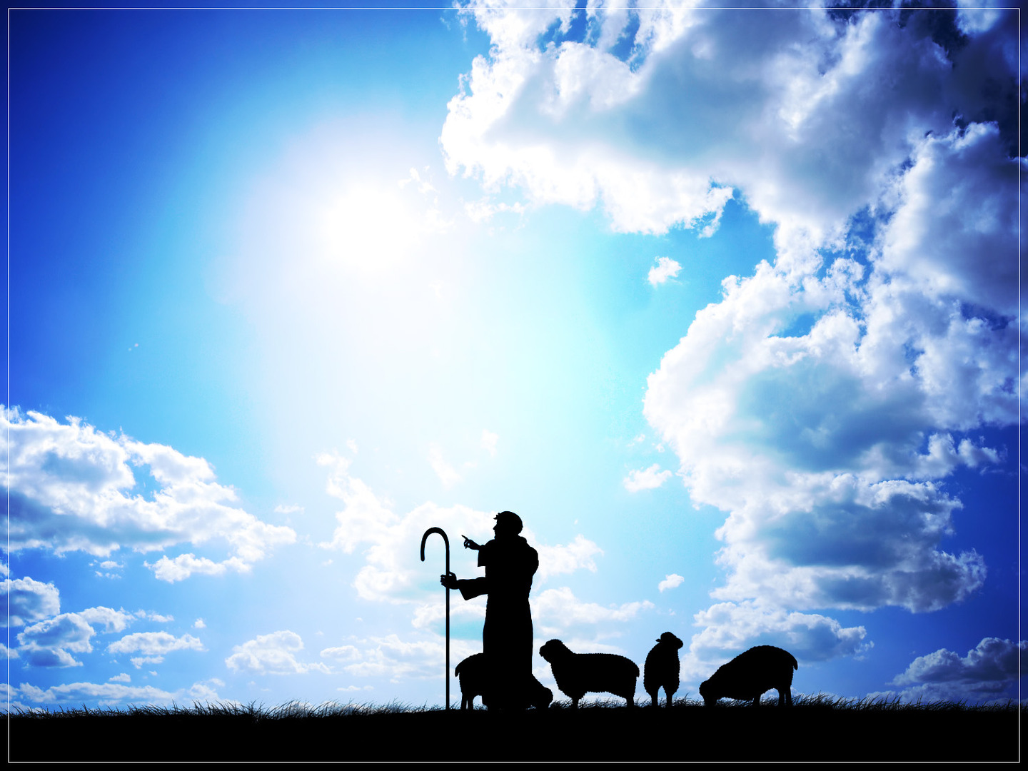
The Life
Of Jesus

Slide 3
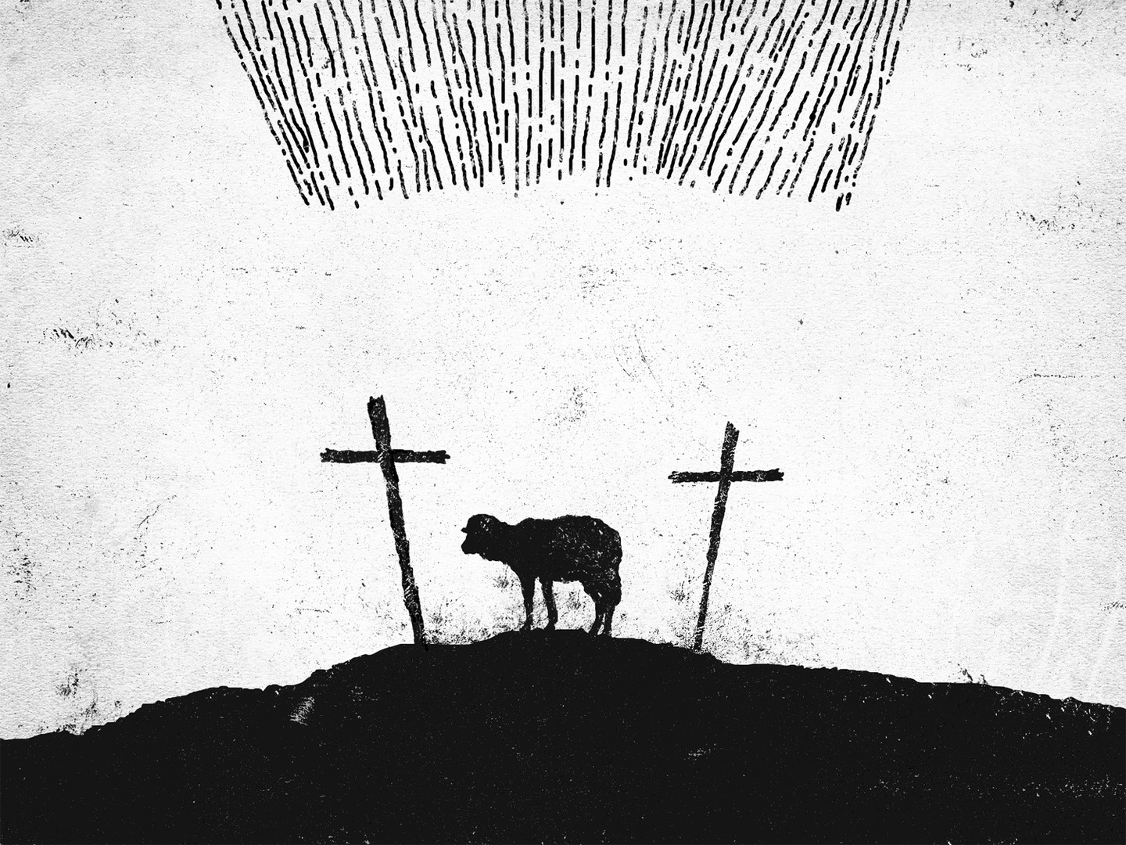
The Death Of Jesus

Slide 4
The Resurrection
Of Jesus

Slide 5
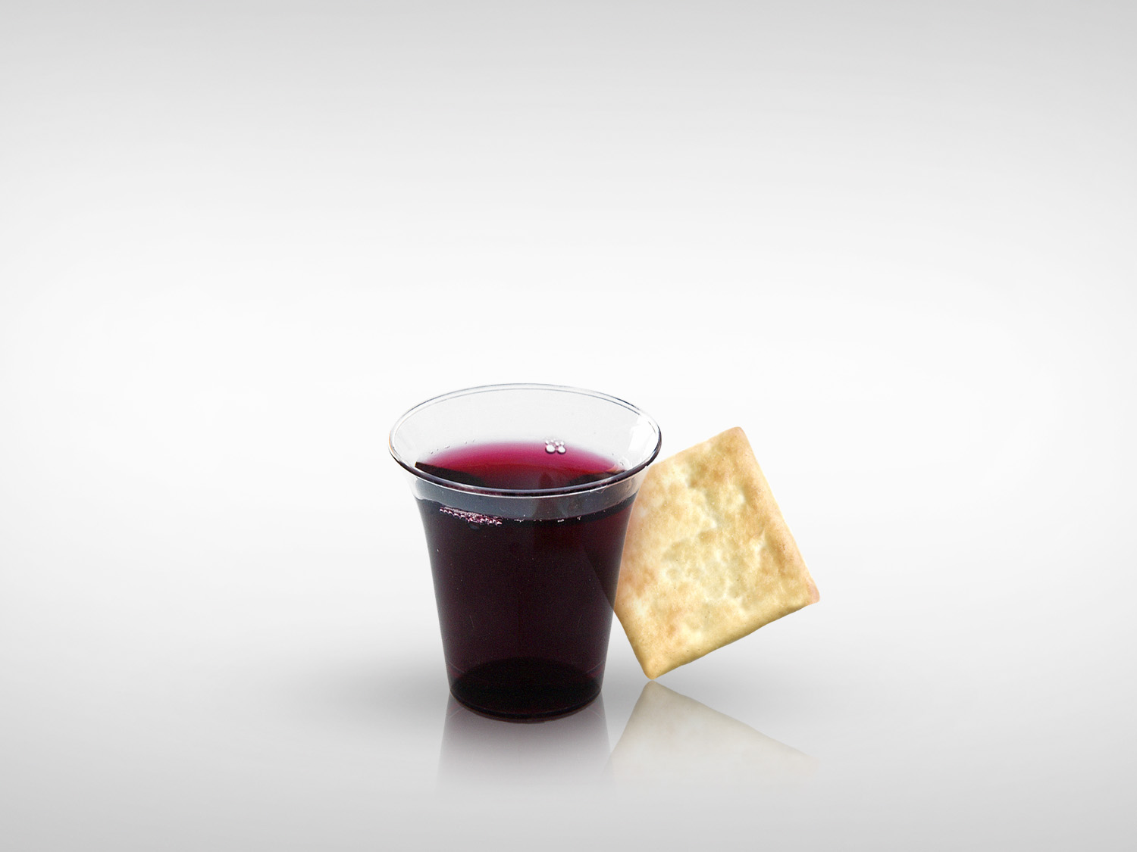
The
LORD’S SUPPER

Slide 6
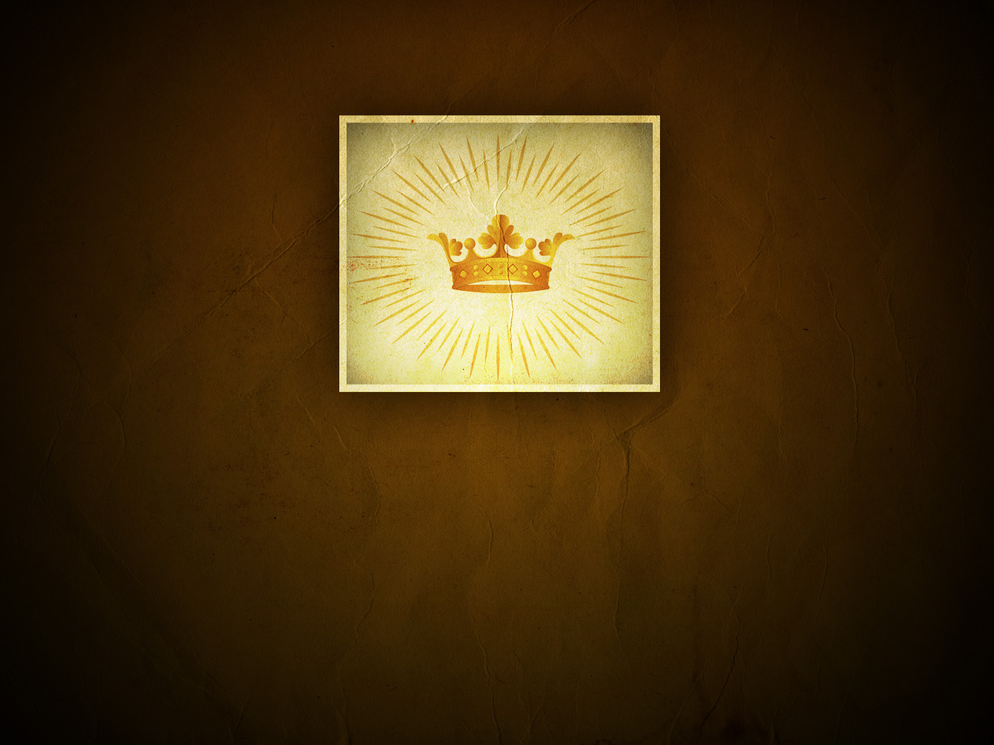
The Coronation Of Jesus

