Slide 1
Questions
and
answers
What Does the Bible Say?

Slide 2
What is the
Proper
attire for
worship?
What Does the Bible Say?

Slide 3
Culture Of Dress Has Changed
In the workplace
At sporting events
In general public places
Proper worship attire
What Does the Bible Say?

Slide 4
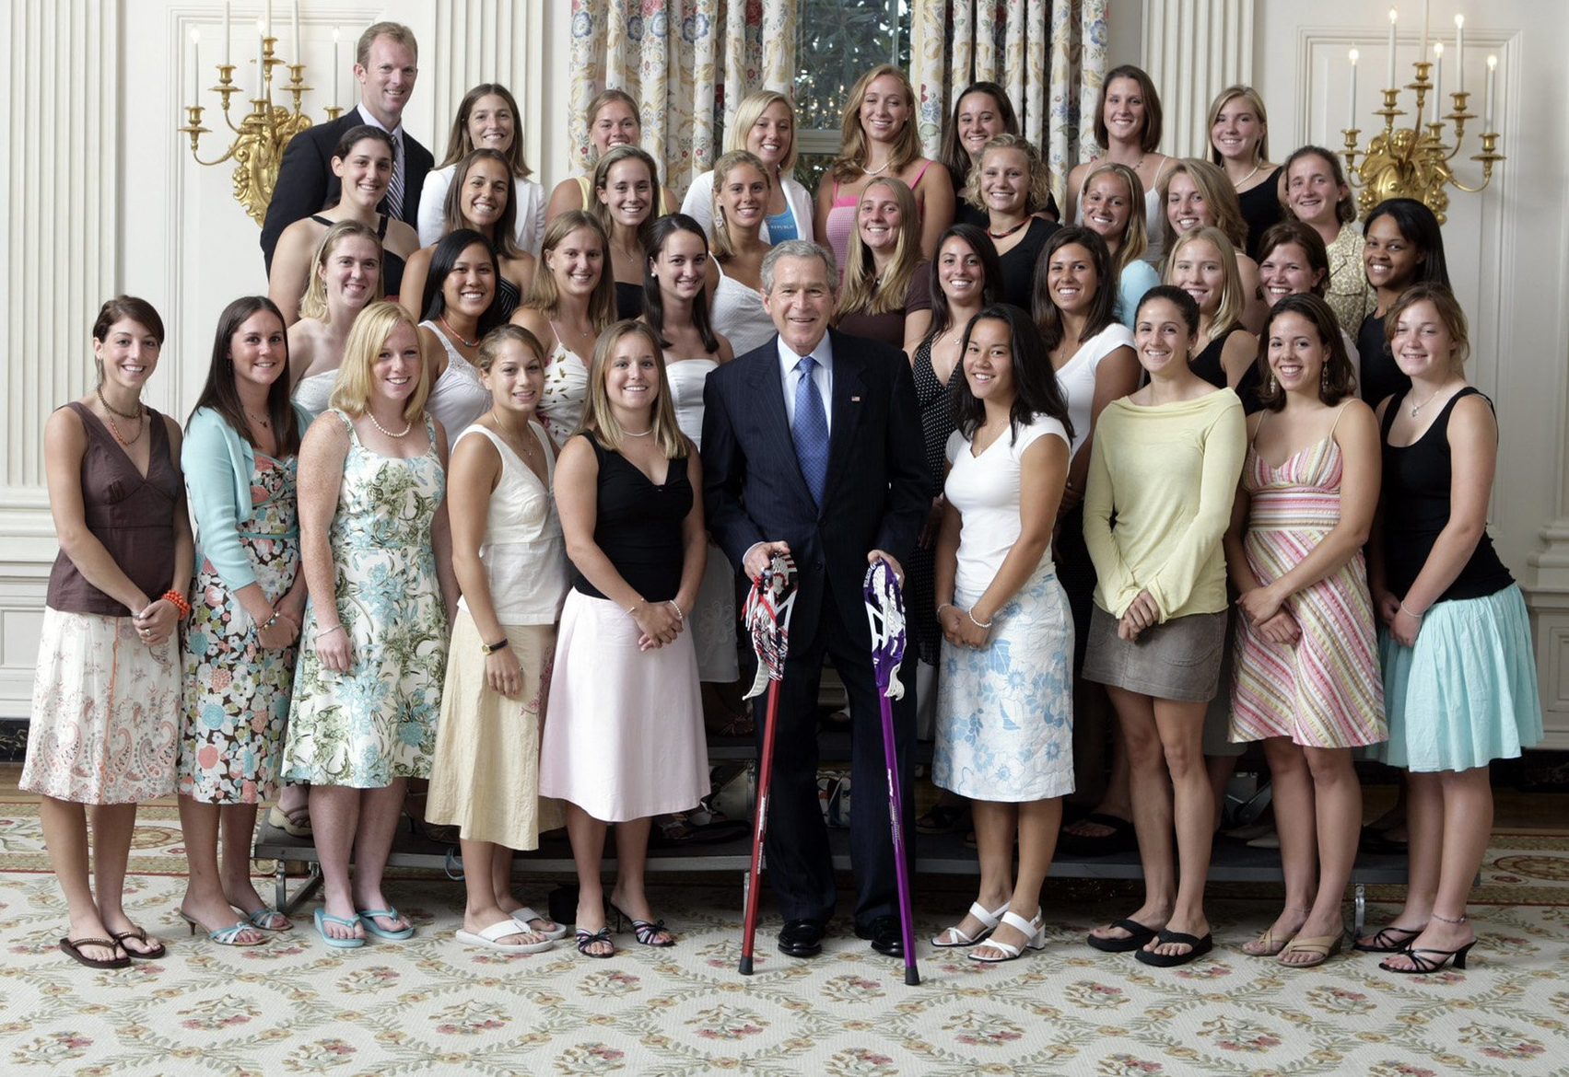

Slide 5
Culture Of Dress Has Changed
In the workplace
At sporting events
In general public places
In worship assemblies
Proper worship attire
What Does the Bible Say?

Slide 6
Things To Consider
Dress is cultural and traditional.
We can’t bind our arbitrary, man-made traditions.
The only biblical mandate is that clothes are to be modest, professing godliness.
Proper worship attire
What Does the Bible Say?

