Slide 1
OCTOBER 29, 2017
HOME and FAMILY
NORTH GARDENDALE CHURCH

Slide 2
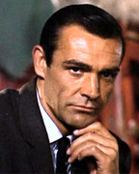
THE LONER
COWBOY
WANTED
THE LADIES'
MAN
THE RICH
GUY
A REAL MAN
THE TOUGH
GUY

Slide 3
THE LEADER
WANTED
EPHESIANS 5:23
THE PROTECTOR
EPHESIANS 5:29
THE TEACHER
EPHESIANS 4:21-32
A MAN
LIKE JESUS
THE FRIEND
JOHN 15:12-14

