Slide 1
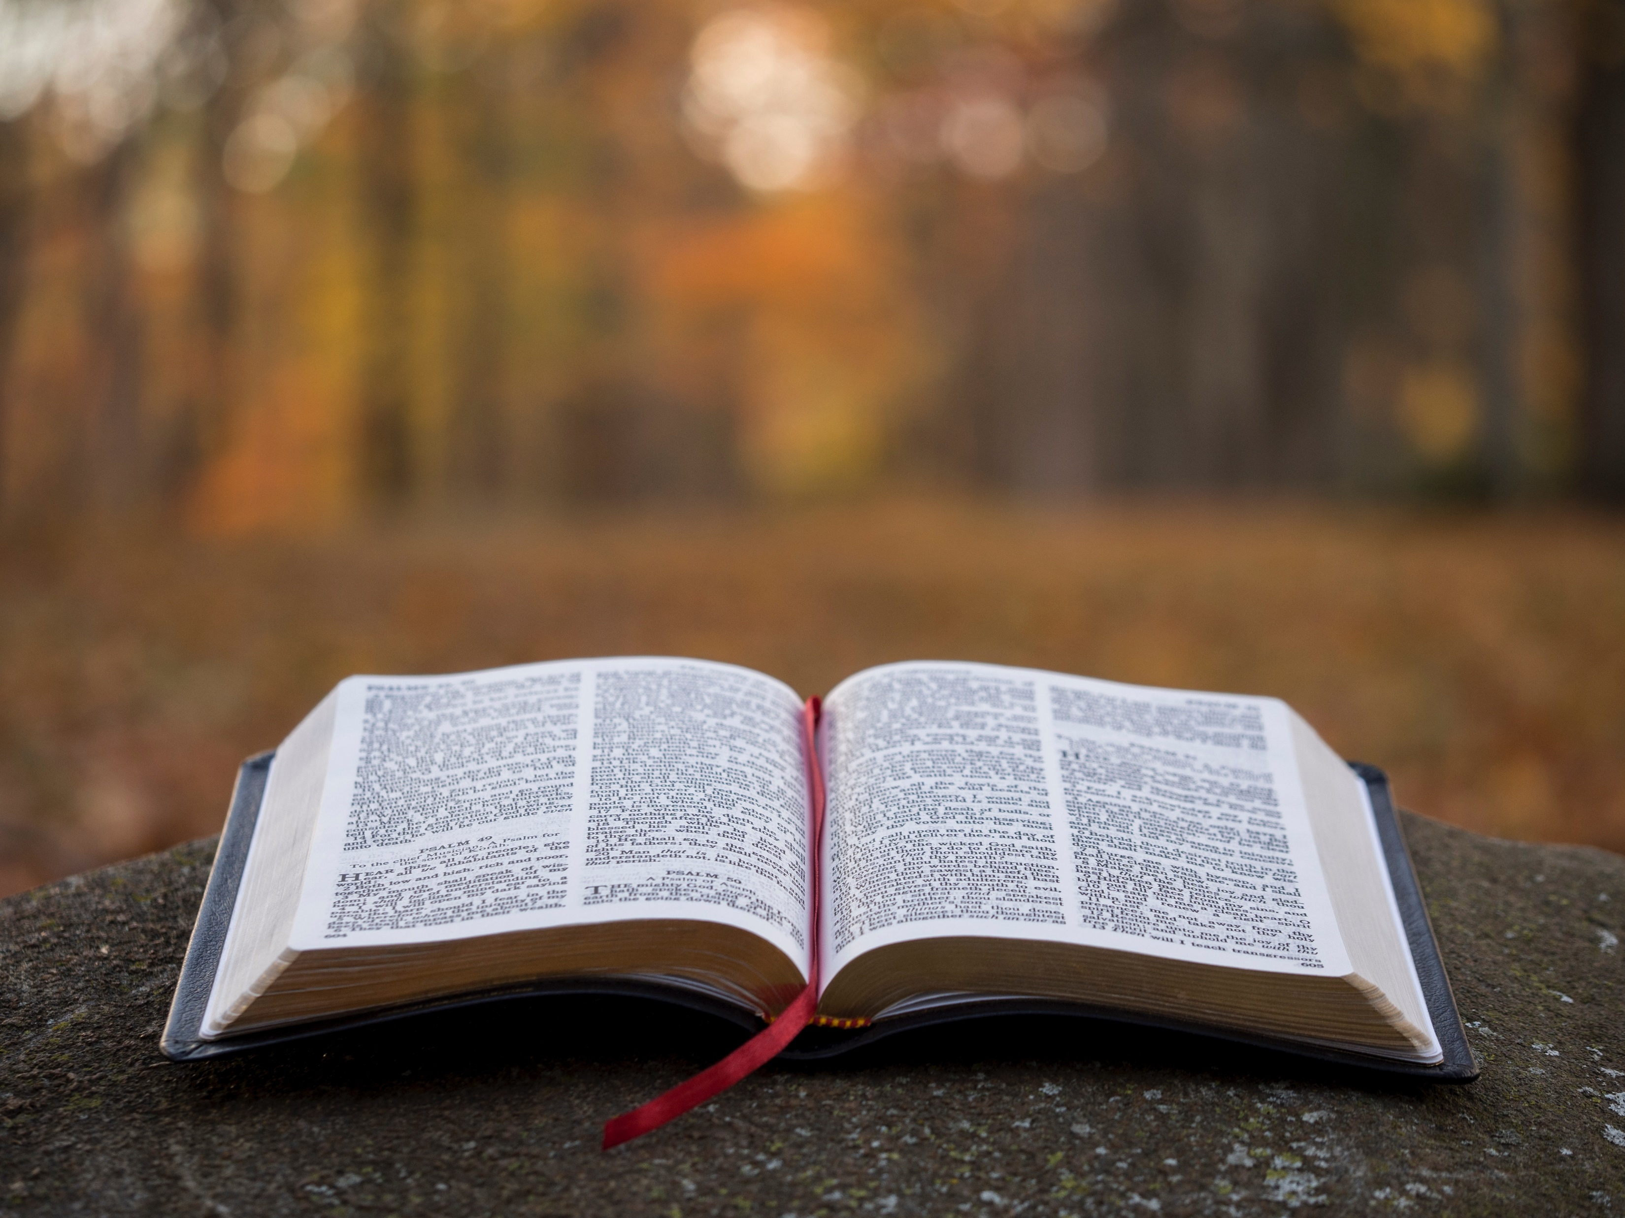
Alleged Bible Contradictions

Slide 4
Contradictions
impossible to reconcile
vs
differences
possible to reconcile

Slide 5
ordering
is chronological
accuracy
compression
is precise
is errant
Selectivity
mystery
is denial
is irreconcilable
Reader

Slide 6
selection
is not denial
helpful
principles
And there are also many other things that Jesus did, which if they were written one by one, I suppose that even the world itself could not contain the books that would be written.
John 21:25

Slide 7
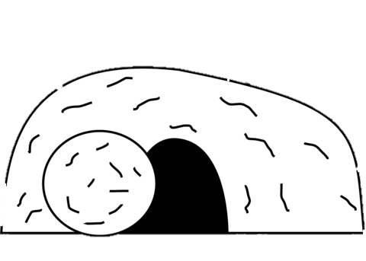
Now the first day of the week Mary Magdalene went to the tomb early, while it was still dark, and saw that the stone had been taken away from the tomb.
Mary Magdalene
John 20:1
THE GOSPEL OF
JOHN

Slide 8
Now the first day of the week Mary Magdalene went to the tomb early, while it was still dark, and saw that the stone had been taken away from the tomb.
Mary Magdalene
John 20:1
THE GOSPEL OF
JOHN

Slide 9
Now the first day of the week Mary Magdalene went to the tomb early, while it was still dark, and saw that the stone had been taken away from the tomb.
Then she ran and came to Simon Peter, and to the other disciple, whom Jesus loved, and said to them, “They have taken away the Lord out of the tomb, and we do not know where they have laid Him.”
Mary Magdalene
John 20:1
THE GOSPEL OF
JOHN

Slide 10
Now after the Sabbath, as the first day of the week began to dawn, Mary Magdalene and the other Mary came to see the tomb.
Mary Magdalene
Mary
Matthew 28:1
THE GOSPEL OF
MATTHEW

Slide 11
Now when the Sabbath was past, Mary Magdalene, Mary the mother of James, and Salome bought spices, that they might come and anoint Him. Very early in the morning, on the first day of the week, they came to the tomb when the sun had risen.
Salome
Mary
Mary Magdalene
Mark 16:1-2
THE GOSPEL OF
MARK

Slide 12
Now on the first day of the week, very early in the morning, they, and certain other women with them, came to the tomb bringing the spices which they had prepared... It was Mary Magdalene, Joanna, Mary the mother of James, and the other women with them, who told these things to the apostles.
Salome
Mary
Mary Magdalene
Joanna
Luke 24:1, 10
THE GOSPEL OF
LUKE

Slide 13
THE GOSPEL OF
JOHN
John
Peter
Peter therefore went out, and the other disciple, and were going to the tomb. So they both ran together, and the other disciple outran Peter and came to the tomb first.
John 20:3-4

Slide 14
THE GOSPEL OF
JOHN
John
Peter
Peter therefore went out, and the other disciple, and were going to the tomb. So they both ran together, and the other disciple outran Peter and came to the tomb first.
John 20:3-4

Slide 15
THE GOSPEL OF
LUKE
Peter
But Peter arose and ran to the tomb; and stooping down, he saw the linen cloths lying by themselves; and he departed, marveling to himself at what had happened.
Luke 24:12

Slide 16
selection
is not denial
IMPRECISION
is not inaccuracy
helpful
principles

Slide 17
Now Pilate wrote a title and put it on the cross. And the writing was: JESUS OF NAZARETH, THE KING OF THE JEWS.
John 19:19
And they put up over His head the accusation written against Him: THIS IS JESUS THE KING OF THE JEWS.
Matthew 27:37
And the inscription of His accusation was written above: THE KING OF THE JEWS.
Mark 15:26
And an inscription also was written over Him in letters of Greek, Latin, and Hebrew: THIS IS THE KING OF THE JEWS.
Luke 23:38

Slide 18
selection
is not denial
IMPRECISION
is not inaccuracy
helpful
principles

