Slide 1
Following the
Messiah
The Final Day:
Roman Trials
Lesson 9

Slide 2
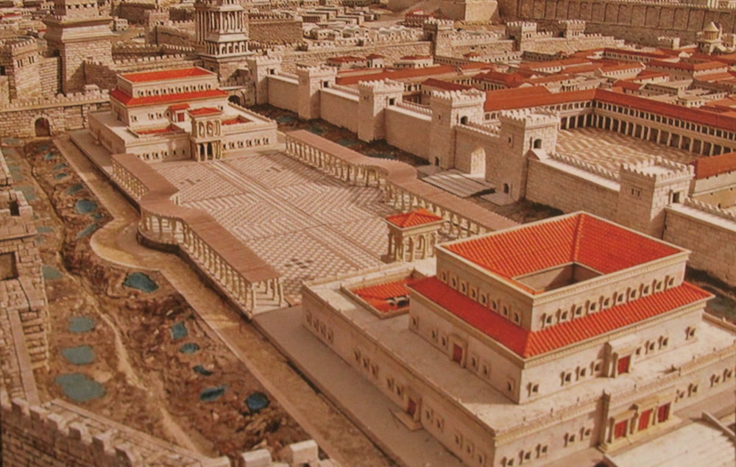

Slide 3
What were the charges that the Jewish officials brought against Jesus?
Following the
The Final Day:
Roman Trials
Messiah
Lesson 9

Slide 4
What particular charge was the focus of Pilate’s questions of Jesus?
Following the
The Final Day:
Roman Trials
Messiah
Lesson 9

Slide 5
Why did Pilate send Jesus to Herod?
Following the
The Final Day:
Roman Trials
Messiah
Lesson 9

Slide 6
What did Pilate do to try to convince the Jews that he should release Jesus?
Following the
The Final Day:
Roman Trials
Messiah
Lesson 9

Slide 7
What was Pilate ultimately concerned with?
Following the
The Final Day:
Roman Trials
Messiah
Lesson 9

