Slide 1
JOB
Faith In The Midst Of Suffering

Slide 2
Eliphaz’s First Speech
(chapters 4-5)
Job’s response
(chapters 6-7)
JOB
Faith In The Midst Of Suffering
Chapters 8-10

Slide 3
What does Job say first in his response? What does he desire?
JOB
Faith In The Midst Of Suffering
Chapters 4-7

Slide 4
What does Job say about his friends?
JOB
Faith In The Midst Of Suffering
Chapters 4-7

Slide 5
Describe Job’s lament (7:1-6). What is Job enduring?
JOB
Faith In The Midst Of Suffering
Chapters 4-7

Slide 6
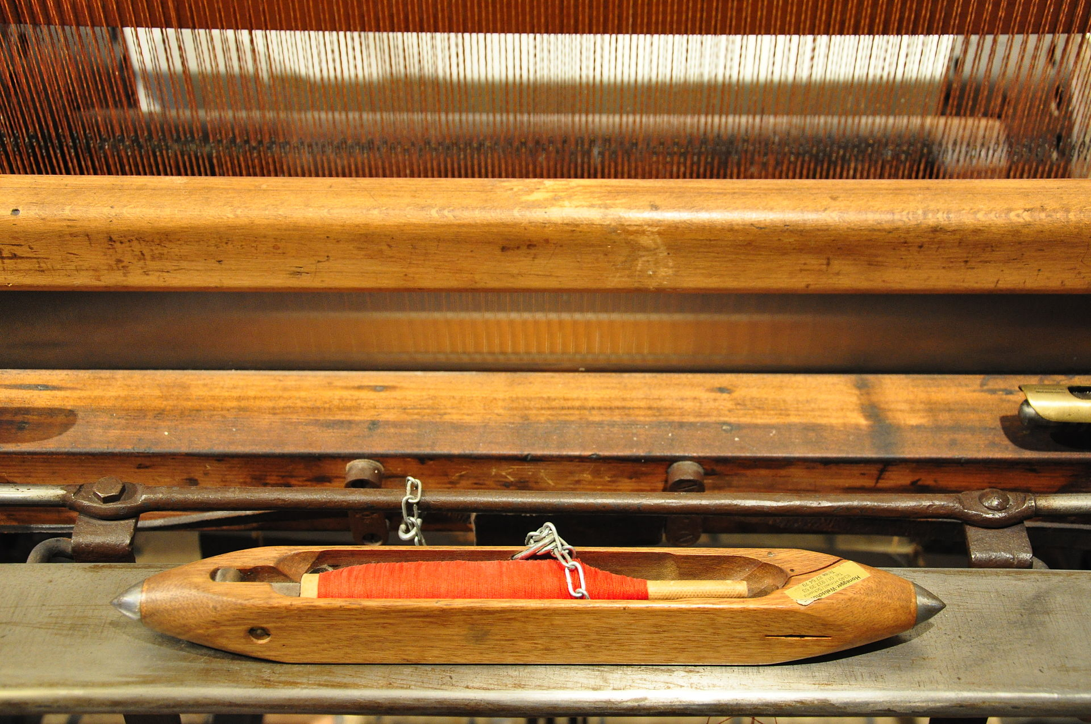

Slide 7
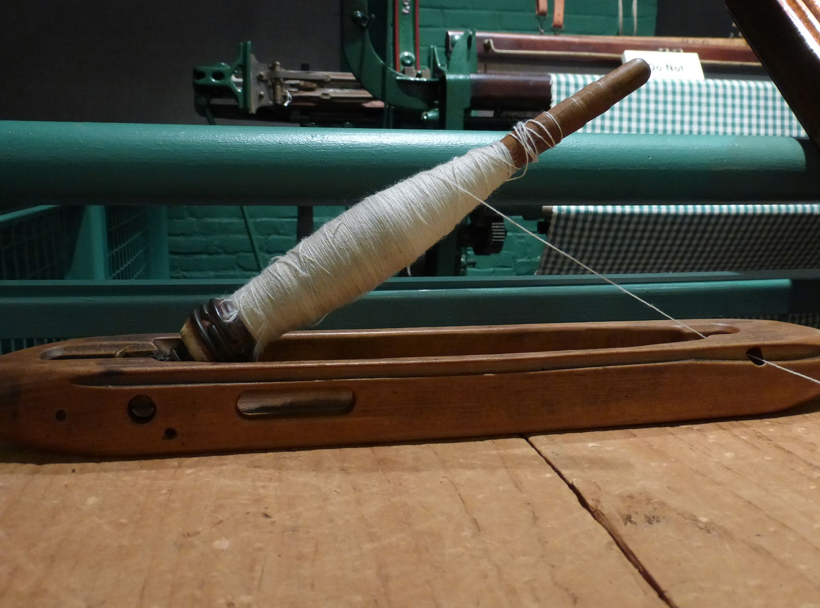

Slide 8
What is Job’s complaint to God?
JOB
Faith In The Midst Of Suffering
Chapters 4-7

Slide 9
Compare and contrast Job 7:17 to Psalm 8:4.
JOB
Faith In The Midst Of Suffering
Chapters 4-7

