Slide 1
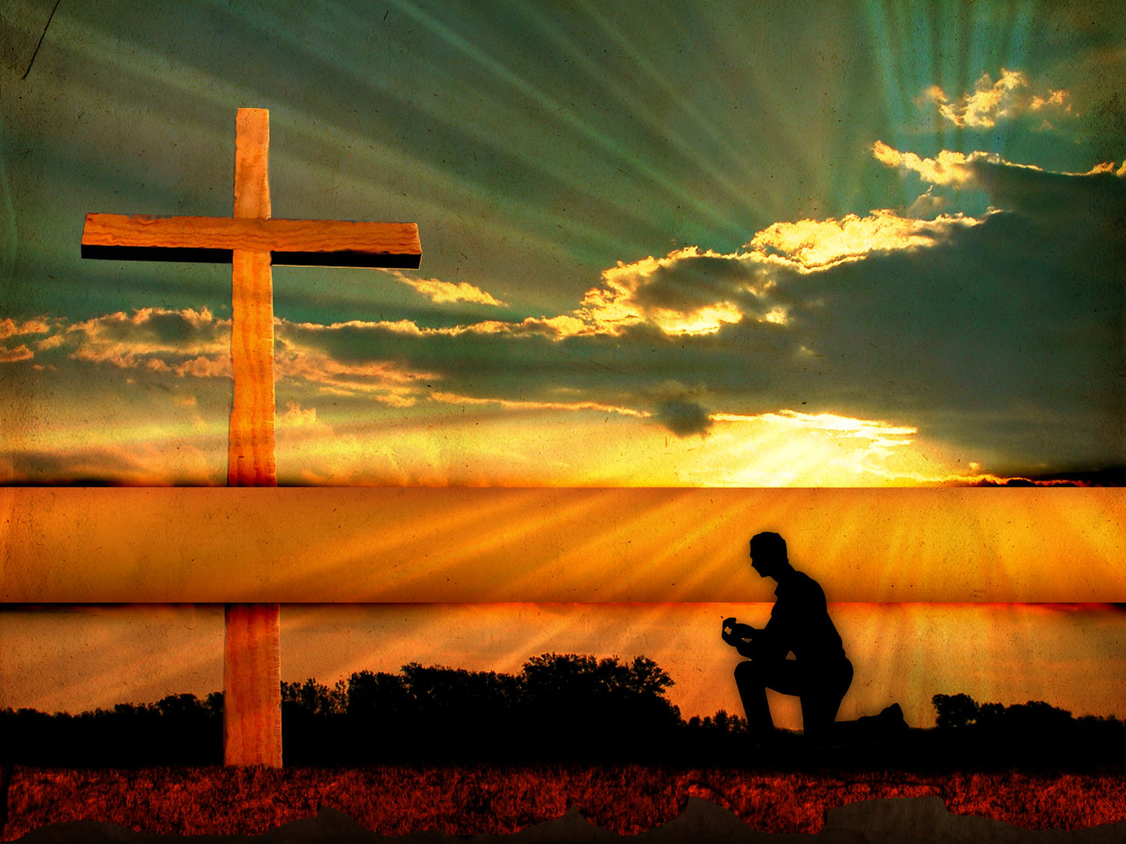
The Gospel of the
grace
of God
Acts 20:24

Slide 2
grace
The Gift Of
Eph. 2:1-10
Without grace, we are dead. With grace, we are alive.
Grace is an act of God’s love.
Grace is a free gift.

