Slide 1
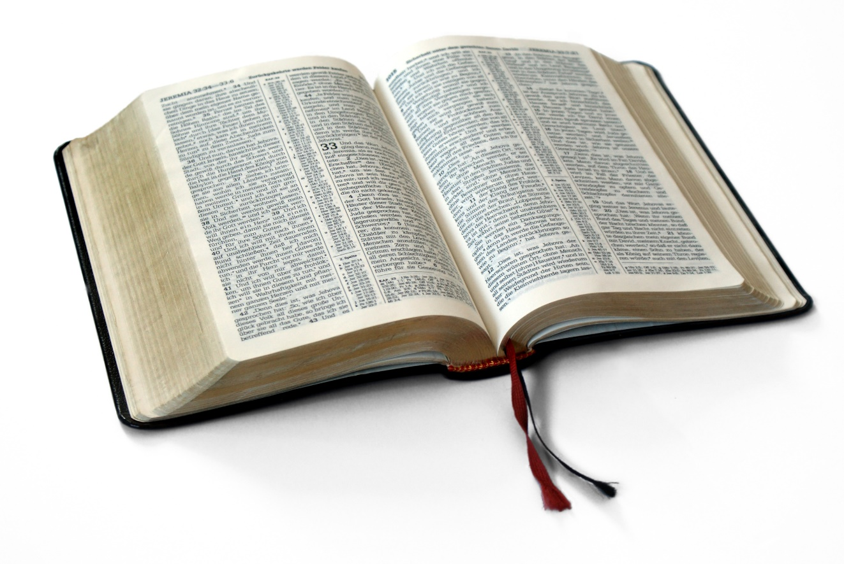
Great Verses
of the Bible
Deuteronomy 6:4-9

Slide 2
Deuteronomy 6:4-9
Loving God involves our entire being.
Great Verses
of the Bible

Slide 3
Deuteronomy 6:4-9
Salvation is through faith – always has been,
always will be.
Great Verses
of the Bible

Slide 4
Great Verses
of the Bible
Deuteronomy 6:4-9

