Slide 1
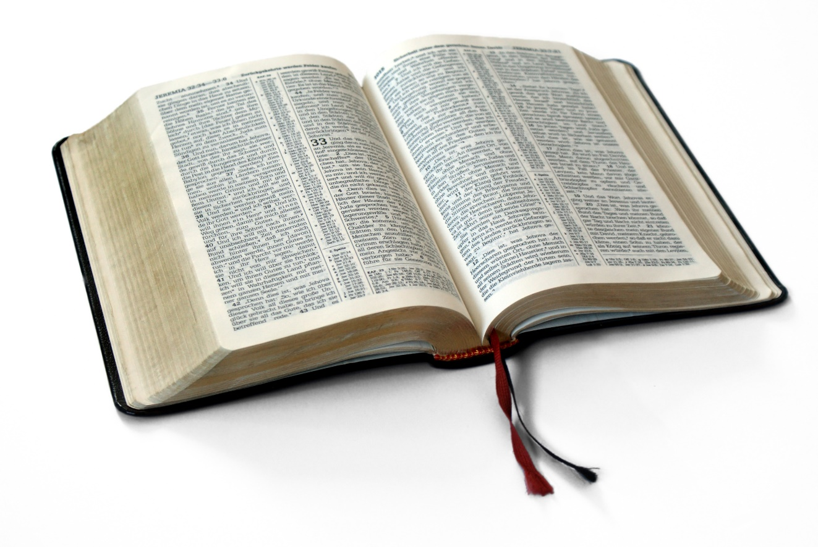
Great Verses
of the Bible
Isaiah 55:8-9

Slide 2
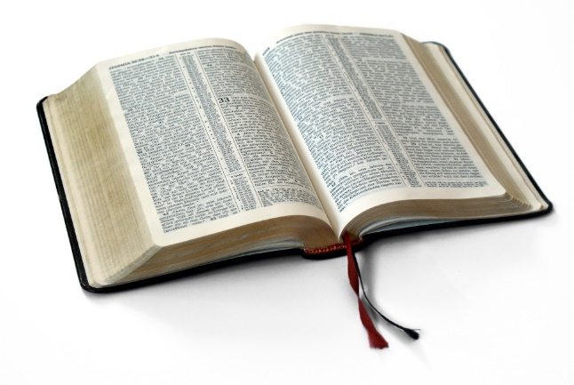
Isaiah 55:8-9
Our ways:
Unsatisfying
Unfulfilling
Death
God’s ways:
Satisfying
Fulfilling
Life
Great Verses
of the Bible

Slide 3
Great Verses
of the Bible
Isaiah 55:8-9

