Slide 1
Growing
Godly Character

Slide 2
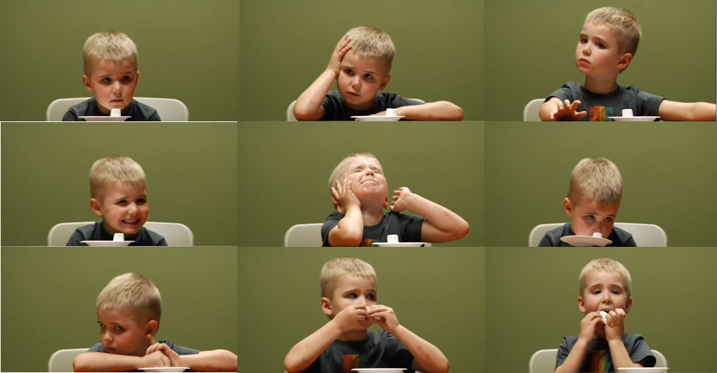
The Marshmallow Test

Slide 3
Growing
Godly Character
Self-control

Slide 4
Change the way you view sin.
Growing
Self-control
Godly Character

Slide 5
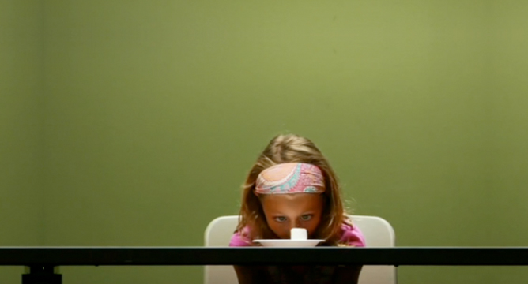

Slide 6
Change what you affix your gaze upon.
Growing
Self-control
Godly Character

Slide 7
Change your relationship with God, Jesus, and the Holy Spirit.
Growing
Self-control
Godly Character

Slide 8
Growing
Godly Character
Self-control

