Slide 1
Alleged Bible Contradictions

Slide 2
Contradictions
impossible to reconcile
vs
differences
possible to reconcile

Slide 3
ordering
is chronological
accuracy
compression
is precise
is errant
Selectivity
mystery
is denial
is irreconcilable
Reader

Slide 4
selection
is not denial
helpful
principles
And there are also many other things that Jesus did, which if they were written one by one, I suppose that even the world itself could not contain the books that would be written.
John 21:25

Slide 5
selection
is not denial
IMPRECISION
is not inaccuracy
helpful
principles

Slide 6
Now Pilate wrote a title and put it on the cross. And the writing was: JESUS OF NAZARETH, THE KING OF THE JEWS.
John 19:19
And they put up over His head the accusation written against Him: THIS IS JESUS THE KING OF THE JEWS.
Matthew 27:37
And the inscription of His accusation was written above: THE KING OF THE JEWS.
Mark 15:26
And an inscription also was written over Him in letters of Greek, Latin, and Hebrew: THIS IS THE KING OF THE JEWS.
Luke 23:38

Slide 7
selection
is not denial
IMPRECISION
is not inaccuracy
helpful
COMPRESSION
is not errant
principles

Slide 9
While He spoke these things to them, behold, a ruler came and worshiped Him, saying, “My daughter has just died, but come and lay Your hand on her and she will live.” So Jesus arose and followed him, and so did His disciples.”
And behold, one of the rulers of the synagogue came, Jairus by name. And when he saw Him, he fell at His feet and begged Him earnestly, saying, “My little daughter lies at the point of death. Come and lay Your hands on her, that she may be healed, and she will live.”
Matthew 9:18-19
Mark 5:22-23
139
words
345
words
Matthew
MARK
uses
8
verses
uses
22
verses

Slide 10
While He spoke these things to them, behold, a ruler came and worshiped Him, saying, “My daughter has just died, but come and lay Your hand on her and she will live.” So Jesus arose and followed him, and so did His disciples.”
And behold, one of the rulers of the synagogue came, Jairus by name. And when he saw Him, he fell at His feet and begged Him earnestly, saying, “My little daughter lies at the point of death. Come and lay Your hands on her, that she may be healed, and she will live.”
STORY OF HEALING THE WOMAN WITH BLOOD DISCHARGE
Matthew 9:18-19
While He was still speaking, some came from the ruler of the synagogue’s house who said, “Your daughter is dead. Why trouble the Teacher any further?” As soon as Jesus heard the word that was spoken, He said to the ruler of the synagogue, “Do not be afraid; only believe.”
Mark 5:22-36

Slide 11
version
version
Matthew
Mark

Slide 12
MONDAY
morning
TEMPLE
BETHANY
Mark 11:12-25

Slide 13
MONDAY
morning
Let no one eat fruit from you ever again.
TEMPLE
BETHANY
Mark 11:12-25

Slide 14
MONDAY
morning
TEMPLE
BETHANY
Mark 11:12-25

Slide 15
MONDAY
morning
TEMPLE
BETHANY
Mark 11:12-25

Slide 16
MONDAY
evening
TEMPLE
BETHANY
Mark 11:12-25

Slide 17
MONDAY
evening
TEMPLE
BETHANY
Mark 11:12-25

Slide 18
TUESDAY
morning
TEMPLE
BETHANY
Mark 11:12-25

Slide 19
TUESDAY
morning
Rabbi, look! The fig tree which You cursed has withered away.
TEMPLE
BETHANY
Mark 11:12-25

Slide 20
TUESDAY
morning
TEMPLE
BETHANY
Mark 11:12-25

Slide 21
TUESDAY
morning
TEMPLE
BETHANY
Mark 11:12-25

Slide 22
MONDAY
morning
TEMPLE
BETHANY
Matthew 21:18-25

Slide 23
MONDAY
morning
Let no fruit grow on you ever again.
TEMPLE
BETHANY
Matthew 21:18-25

Slide 24
MONDAY
morning
TEMPLE
BETHANY
Matthew 21:18-25

Slide 25
MONDAY
morning
TEMPLE
BETHANY
Matthew 21:18-25

Slide 26
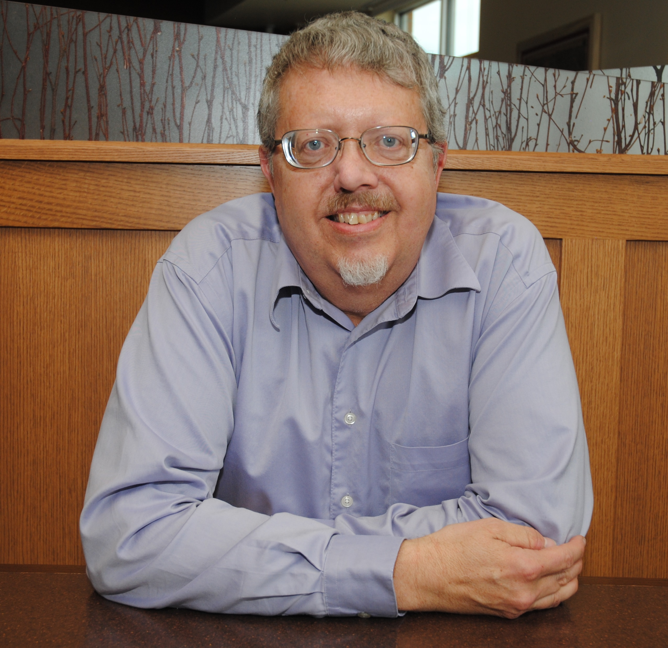
In his desire to create a neater literary narrative, Matthew puts both parts of the fig tree story together, creating the illusion that it all took place on one day. Still, Matthew never says this in so many words, and the language of ‘immediate’ withering is still appropriate even if it took place over several hours. Trees normally take far longer to decay!
Craig Blomberg
NEW TESTAMENT SCHOLAR

Slide 27
selection
is not denial
IMPRECISION
is not inaccuracy
helpful
COMPRESSION
is not errant
principles
THEMATIC ORDERING
is not chronological

