Slide 1
Following the
Messiah
Jesus Calms the Sea
Lesson 12

Slide 2
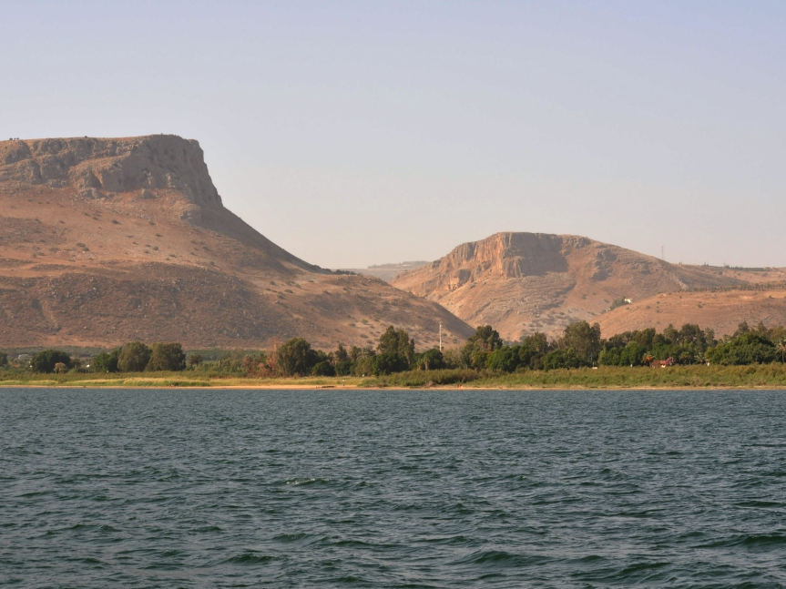

Slide 4
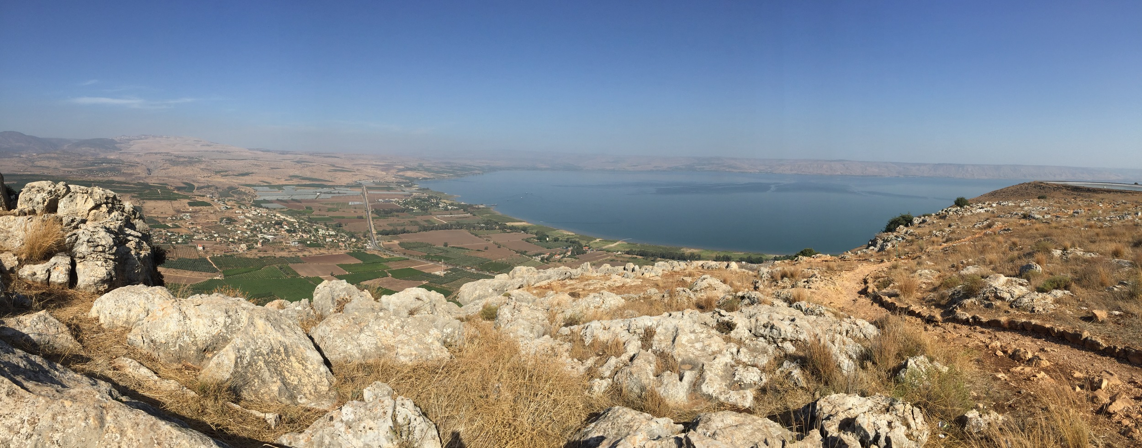

Slide 6
Why is Jesus calming the storm so significant?
Following the
Messiah
Jesus Calms the Sea
Lesson 12

